Slide 1
Voting process
Presented by
R.Ramyasree(24KB1A3089)
G.Harshitha(24KB1A3030)
J.Neha(24kB1A3037)

Slide 2
ABSTRACT:
This project is a basic voting system developed in C using the queue data structure.
Voters are added to a queue and allowed to vote in the order they arrive,just like in a real polling station.
Each voter has a name and must be verified before voting.
Verified voters can choose one of the available candidates, and there are counted.
The system also keeps track of who voted for each candidate and displays the final result with vote counts.
This project helps to understand how queues work in real-world situations using Simple C programming.

Slide 3
System requirements:
C programming language.
Basic knowledge of arrays and structures.
Console-based interface for demonstration.
System design overview:
Voters register and are added to the queue.
Each voter votes when their turn arrives(dequeued).
Voters are recorded and tallied-Result displayed after all voters have voted.

Slide 4
Header file:
#include<stdio.h> : Includes the standard input/output library which provides functions for input and output operations.
#include<stdlib.h> : It provides functions for memory allocation, process control, conversions and other utilities.
#include<string.h> : Includes standard library functions which provides functions for C strings such as strcpy( ),strlen( ) and strcmp( ).

Slide 5
Defining constant:
#define MAX_CANDIDATES:
Sets the maximum number of candidates in the voting system to 3.
Anywhere MAX_CANDIDATES appears in the code, it will be replaced with 3 by the preprocessor.
2. #define MAX_NAME_LENGTH 50:
Sets the maximum length for a voter's name to 50 characters (including the null terminator).
Used to define the size of character arrays that store names.

Slide 6
3. #define RESULT_FILE "voting_results.txt”:
Defines the name of the file where voting results will be saved as "voting_results.txt".
Used in file operations to refer to the results file.
4.#define MAX_VOTERS :
Sets the maximum number of voters allowed in the system to 3.
Used to define the size of arrays and limits for voter-related operations.

Slide 7
typedef struct Voter {
char name[MAX_NAME_LENGTH];
int id; int verified;
int votedFor;
struct Voter* next;
} Voter;
typedef struct Queue {
Voter* front;
Voter* rear;
} Queue;
1. Structure Definition
2. Fields Explained
3. Typedef Usage

Slide 8
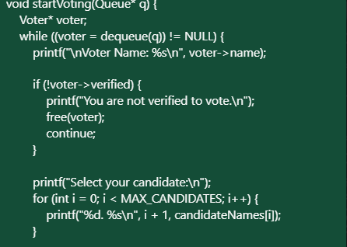
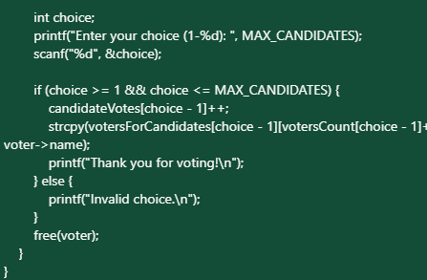
Logic code:

Slide 9
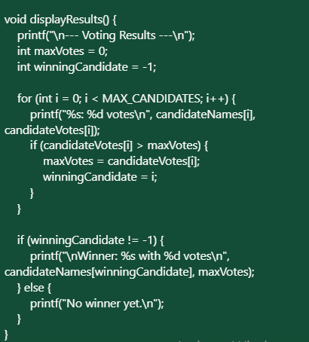
Display results:

Slide 10
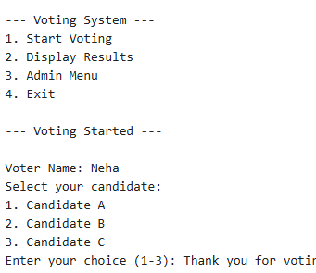
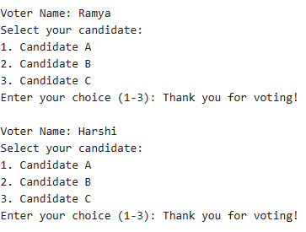
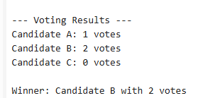
Sample output:

Slide 11
ADVANTAGES OF QUEUE BASED ON VOTING SYSTEMS:
Simple, fair, and prevents manipulation.
Easy to implement and debug.
Scalable for larger scales.
LIMITATIONS AND IMPROVEMENTS:
Limited by queue size(array implementation).
No real-time authentication in console version.
Can be extended with linked list for dynamic size.

Slide 12
Conclusion:
Queue ensures fair,sequential voting.
C implementation demonstrates core data structure concepts.
Foundation for more advanced, secure voting systems.

Slide 13
Future enhancements:
Unique voter identification:
Assign each voter a unique ID to ensure one vote per person.
Prevents impersonalisation and duplicate voting.
Biometric or OTP Verification:
Simulate biometric or OTP-based verification to verify voter identity before voting.

Slide 14
THANK YOU ANY SUGGESTIONS

